Slide 1
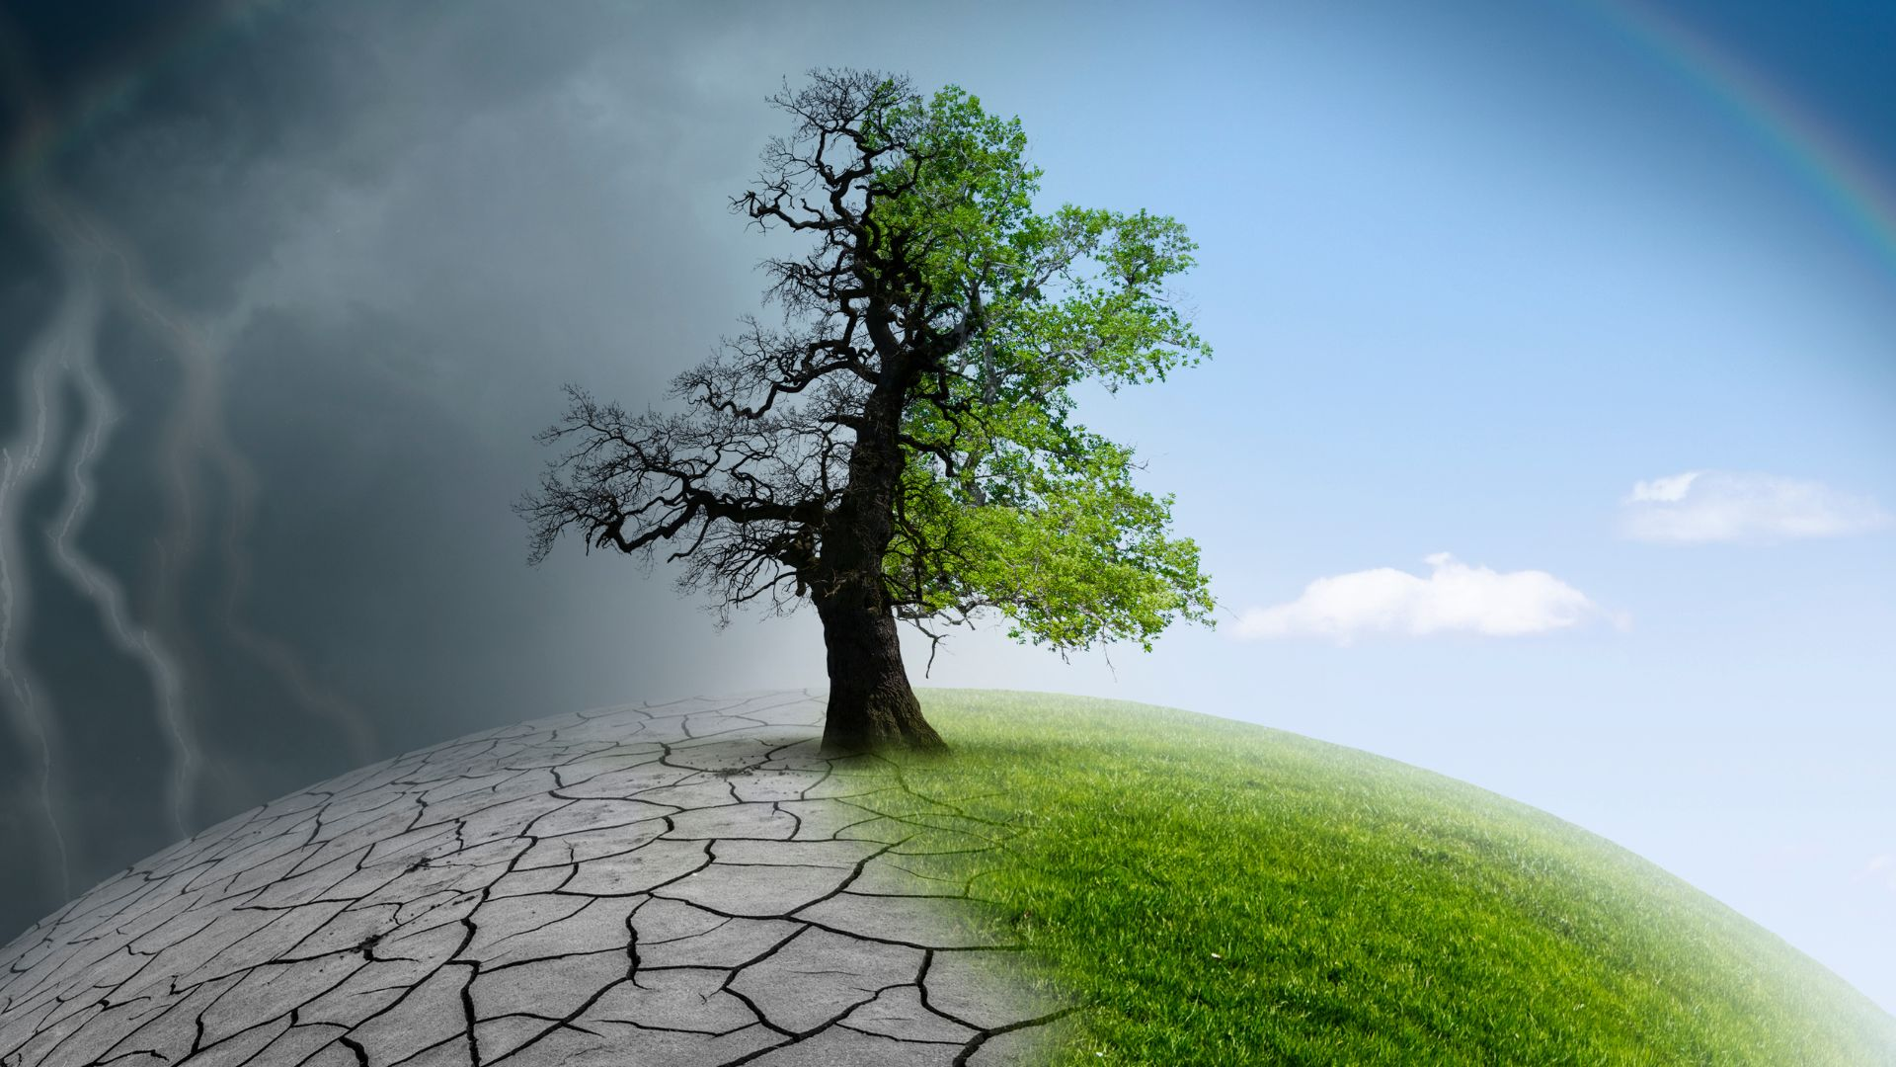
Climate Change Causes
Effects, and Solutions

Slide 2
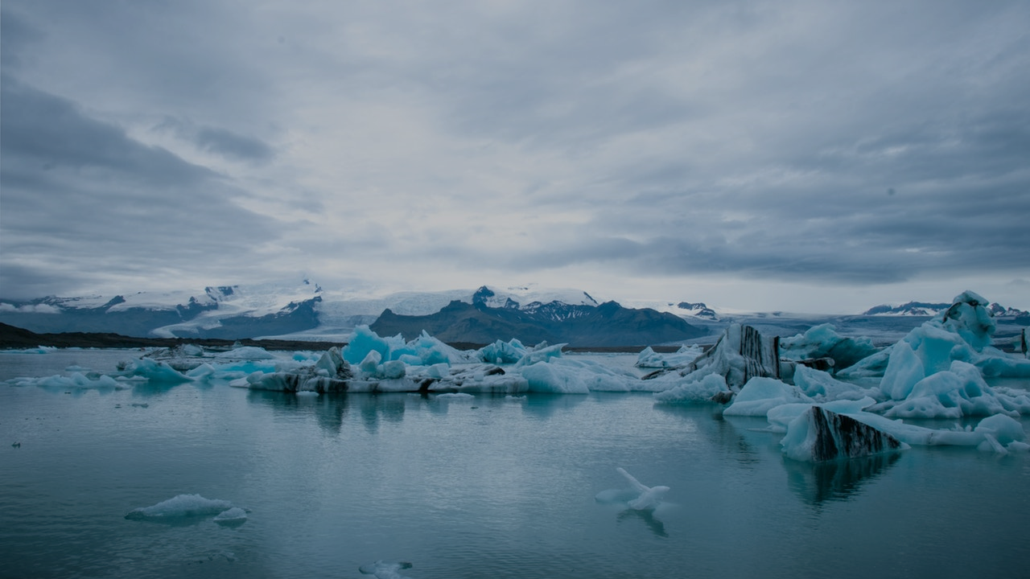
What is Climate Change?
Definition: Long-term alteration of temperature and typical weather patterns in a place.
Key Point: While climate change is a natural phenomenon, recent trends are largely driven by human activities.

Slide 3
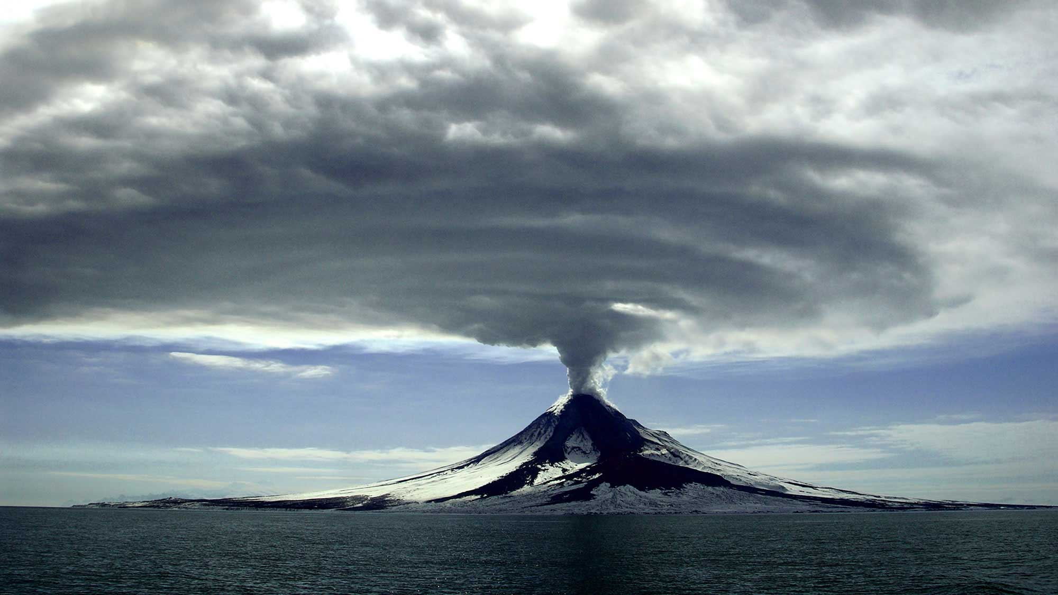
Natural Causes of Climate Change
Volcanic Eruptions: Release of ash and gases can cool the Earth temporarily.
Solar Variations: Changes in solar energy output.
Ocean Currents: Influence global climate patterns.
Orbital Changes: Milankovitch cycles affecting Earth's climate over thousands of years.

Slide 4
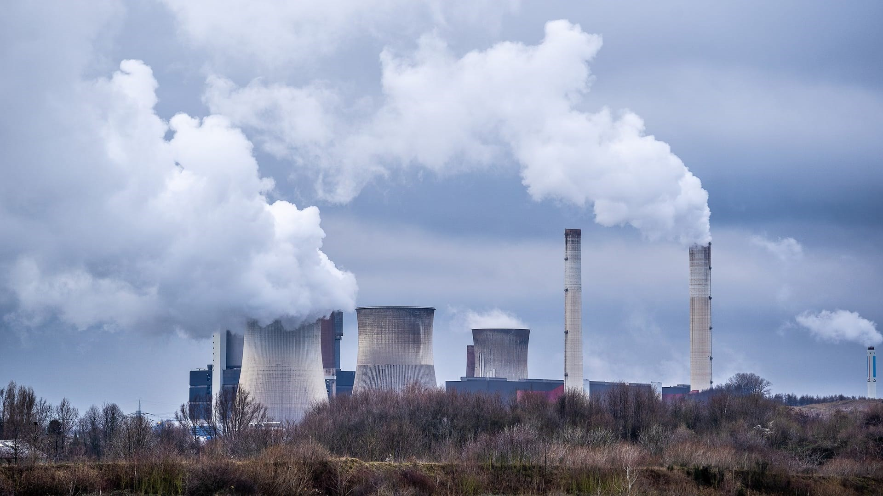
Human-Induced Causes
Burning Fossil Fuels: Coal, oil, and gas combustion increases greenhouse gases.
Deforestation: Reduces carbon sequestration capacity.
Industrial Activities: Emit various greenhouse gases.
Agriculture: Methane emissions from livestock and rice paddies.

Slide 5
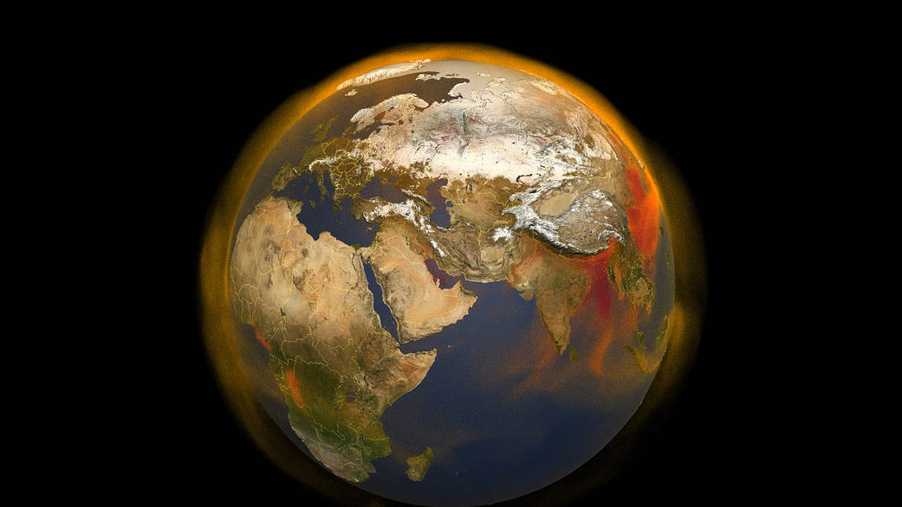
Greenhouse Effect Explained
Mechanism: Greenhouse gases trap heat in the atmosphere, leading to global warming.
Major Gases: Carbon dioxide (CO₂), methane (CH₄), nitrous oxide (N₂O), and fluorinated gases.

Slide 6
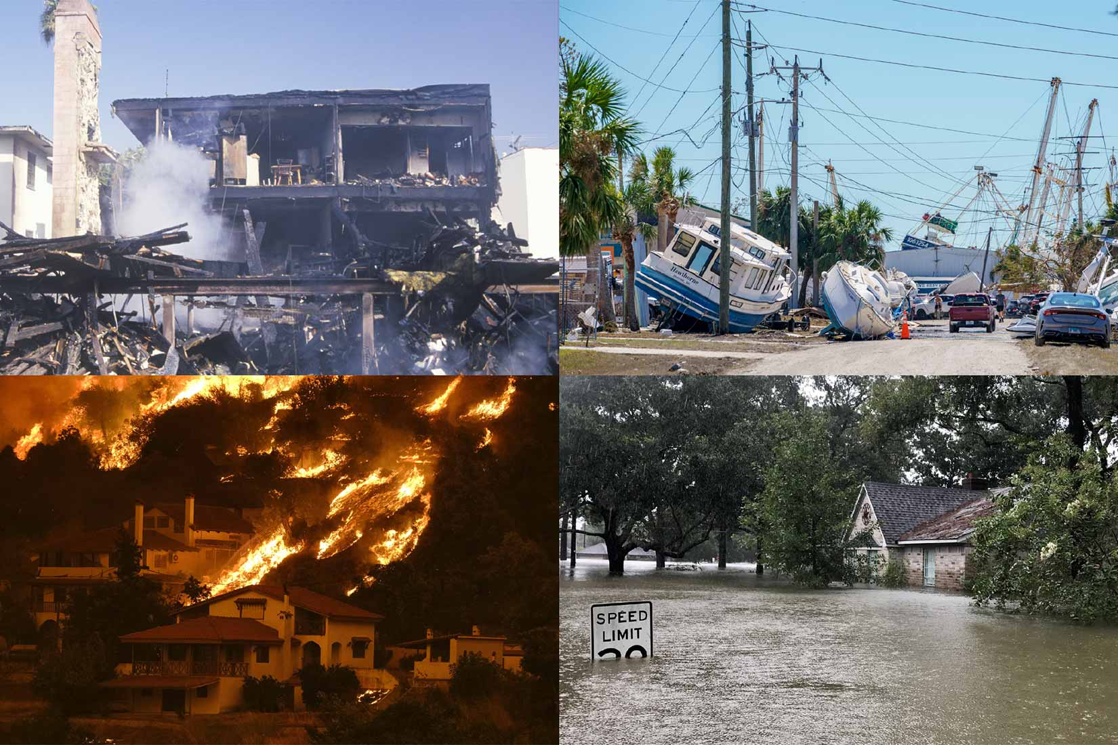
Effects of Climate Change
Rising Temperatures: Global average temperatures are increasing.
Melting Ice Caps: Leads to sea-level rise.
Extreme Weather Events: Increased frequency and intensity of storms, droughts, and heatwaves.
Ocean Acidification: Affects marine life and coral reefs.

Slide 7

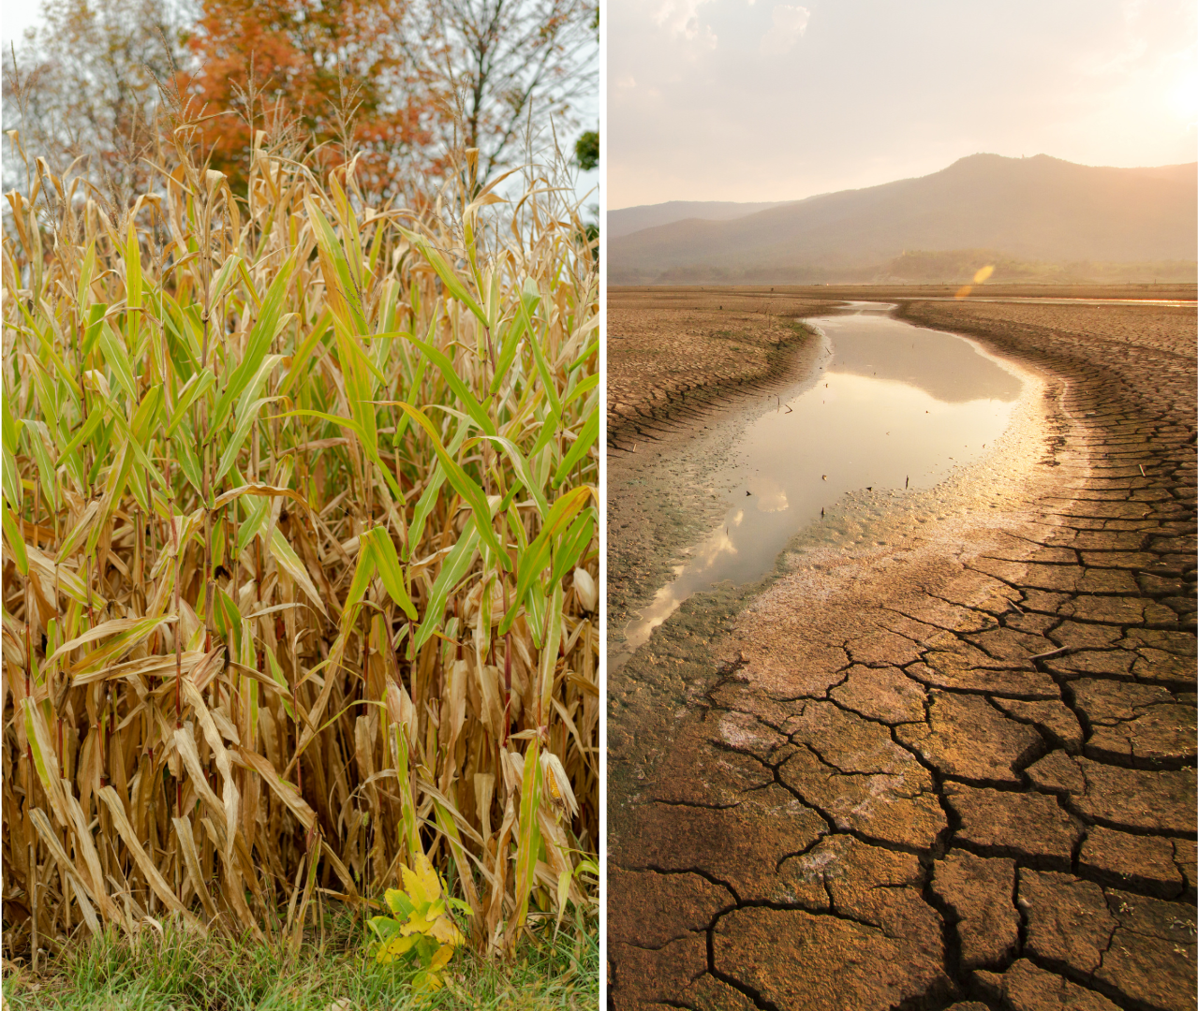
Human Health and Societal Impacts
Economic Strain: Damage to infrastructure and increased disaster recovery costs.
Food Security: Crop yields affected by changing climates.
Health Risks: Increased respiratory and cardiovascular diseases.

Slide 8

Global Solutions
Renewable Energy: Transition to solar, wind, and hydroelectric power.
Energy Efficiency: Improving insulation, appliances, and industrial processes.
Carbon Pricing: Implementing taxes or cap-and-trade systems.
International Agreements: Paris Agreement aims to limit global warming to well below 2°C.

